Slide 1
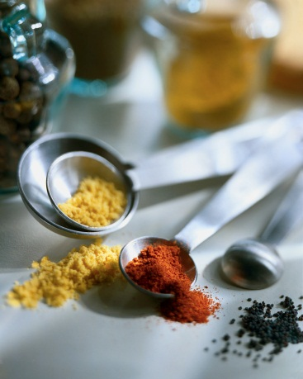
Measuring, Abbreviations and Equivalents
Today we will:
Learn how to read and interpret a recipe.
Review abbreviations and equivalents.
Identify proper lab procedures.

Slide 2
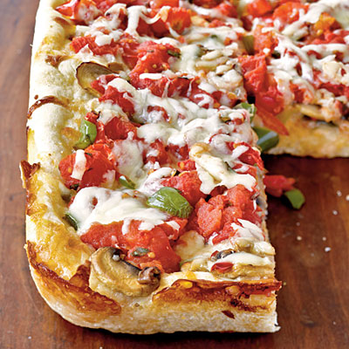
Foods Unit Review
Get Your Dry Erase Board READY!!!
Kitchen Tools Cooking Terms Safety
Watch the video clip and write down the kitchen tools used, cooking terms mentioned, and kitchen safety.
http://www.emerils.com/tv/emerils-table Click on Perfect Mashed Potatoes!

Slide 3
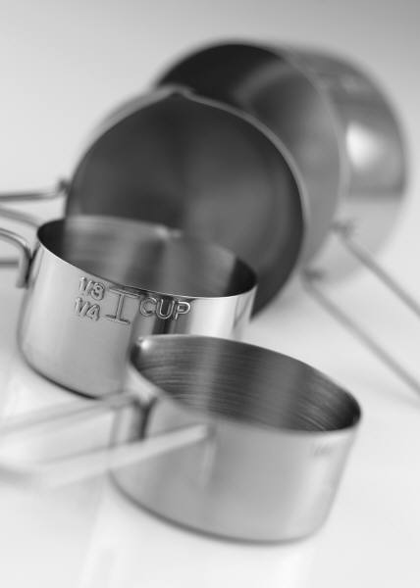
Dry Ingredients
Use measuring cups
Some ingredients are spooned into the measuring cup (ex. flour)
Some ingredients are packed into the measuring cup. (ex. Brown sugar)
All ingredients need to be leveled with a spatula/leveler or knife.
What are some examples of dry ingredients?

Slide 4
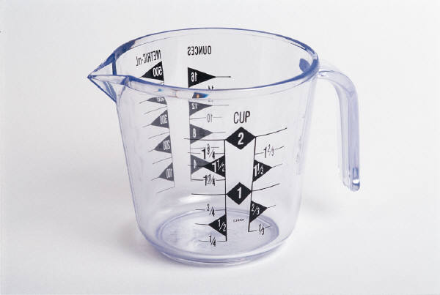
Liquid Ingredients
Use a liquid measuring cup.
Make sure you are at eye level!
What are some examples of liquid ingredients?

Slide 5
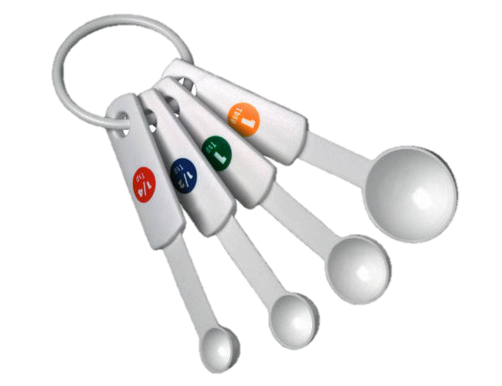
Common Ingredients in Small Amounts
Used for liquid or dry ingredients in small amounts.
A set usually includes: 1 Tablespoon, 1 teaspoon, ½ teaspoon, ¼ teaspoon
Remember: Dry ingredients still need to be leveled!
Name three examples.

Slide 6
What tool would I use to measure the following?
1 cup of peanut butter?
2 cups of milk?
4 cups of oatmeal?
3 t. of vanilla?
1/3 cup of yogurt?
dry measuring cup
liquid measuring cup
dry measuring cup
measuring spoons
dry measuring cup

Slide 7
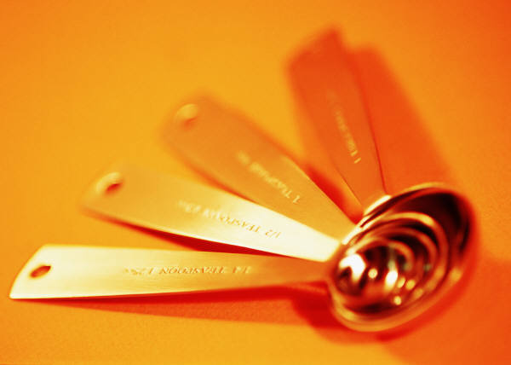
Measuring Abbreviations
=teaspoon
=Tablespoon
= Cup
= hour
= dozen
tsp. t.
T. Tbsp. TB.
c. C.
hr.
doz.

Slide 8
Measuring Abbreviations
oz.
= ounce
= pint
= quart
= gallon
= pound
pt.
qt.
gal.
lb. #

Slide 9
Equivalents
=1 tablespoon
= ½ T.
=1/4 cup.
=1 cup
=1 cup
3 tsp.
1 ½ tsp.
4 T.
16 T.
8 oz.

Slide 10

Equivalents
=1 pint
=1 pint
= 1 quart
=1 quart
= 1 gallon
16 oz.
2 cups
2 pints
4 cups
4 quarts

Slide 11
Stick Butter or Margarine
= 1 lb.
=1 stick
=½ stick
=1 stick
= ½ stick
4 sticks
½ cup
¼ cup
8 T.
4 T.

